Slide 1

UNIT 7B
HOW DO YOU SAY THIS WORD IN ENGLISH?

Slide 2
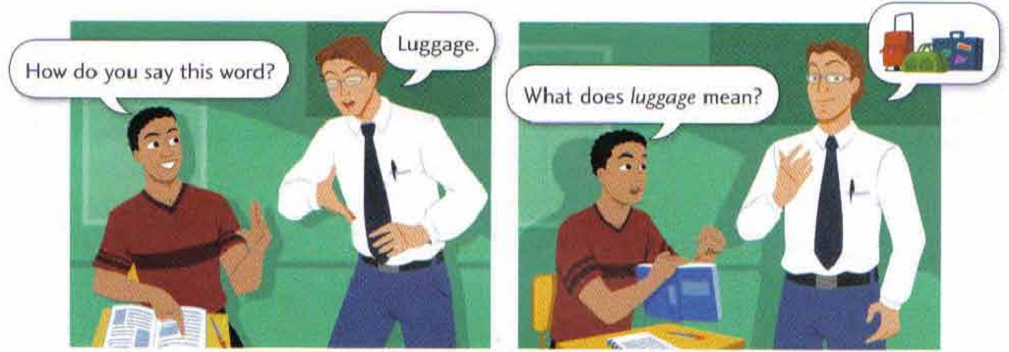



CONVERSATION
MUSIC
Of course, I like to ...
How do you say this word in English?
Do you like to listen to
music?
A: Excuse me! How do you say this word in English?
B: Oh, “MUSIC”
A: What does it mean?
B: It means “ÂM NHẠC”.
A: I see. By the way, do you like to listen to music?
B: Yes, I like to listen to music.

Slide 3
PAIR WORK
A: Do you want to listen to music? A: Do you like to watch TV?
B: Yes, I want to listen to music. B: No, I don’t like to watch TV.
Want to …/ Like to …
listen to | music, the radio
draw | flowers, animals
watch | a movie, a play
make | cakes, toys
show | your photos, your videos
conduct | music, a class
observe | the stars, the moon
have | a bicycle, a car
pass | the TOEIC, the TOEFL
turn on | the fan, the light
smoke | a cigar, a cigarette
play | the guitar, the piano
Have to … / Need to …
store | meat, rice
submit | homework, a report
do | the housework, homework
review | the vowels, the consonants
cook | lunch, dinner
clean | the floor, the fan
wash | the windows, the dishes
feed | the cat, the dog
put on | a scarf, gloves
cover | the book, the notebook
understand | grammar, vocabulary
carry | a bag, a map
smoke | a cigarette, a cigar
cook | lunch, breakfast
put on | a hat, a scarf
build | houses, bridges
sign | a letter, a contract
catch | a bus, a taxi
unlock | the gate, the suitcase
serve | coffee, tea

